Slide 1
Twitter social network analysis
Anna Irgizbayeva
Ildar Beisekenov
Advisor: Mark Sterling

Slide 2
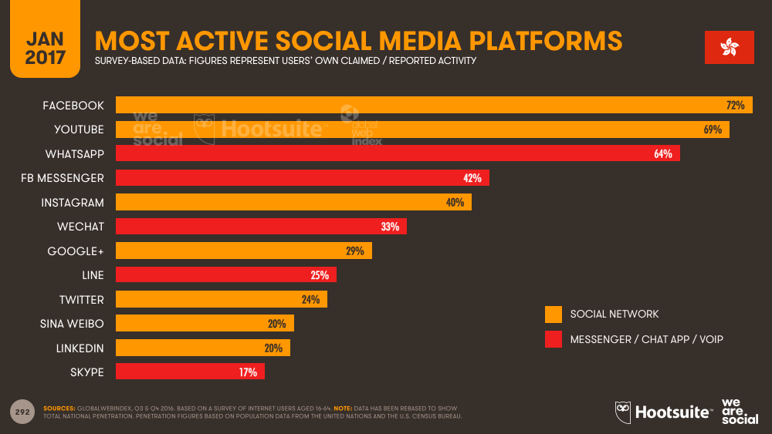
Source: https://wearesocial.com/special-reports/digital-in-2017-global-overview

Slide 3

Twitter
Popular microblogging site
Short Text Messages of 280 characters
240+ million active users
500 million tweets are generated everyday
Twitter audience varies from common man to celebrities
Users often discuss current affairs and share personal views on various subjects
API

Slide 4

Semantic analysis using Machine Learning approach
Small dataset
Classification of users
Python’s XGBoost library
92 % accuracy

Slide 5

Challenges
Rate limitation
Time limitation
Computation cost

Slide 6
Statistical approach for social network analysis

Slide 7
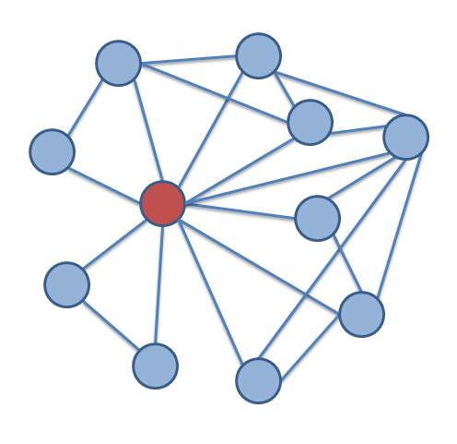
Ego network
Blue nodes – followers
Red node – centric user
Edges - relationships

Slide 8

Data collection
Centric user – NU GSB
380 followers
Tree depth of 2
Much more nodes

Slide 9
Data collection
101,639 edges
101,316 nodes

Slide 10
Data collection
101,639 edges
101,316 nodes
81,875 real nodes

Slide 11


Tools
Python programming language
Tweepy API
NetworkX library
The Open Graph Viz Platform

Slide 12
Tools
Simplicity and flexibility
Rate limit
Easy creation of social data connectors to map community

Slide 13
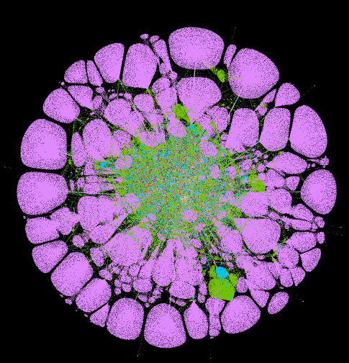
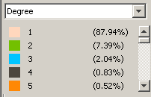
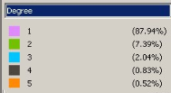
Data interpretation

Slide 14
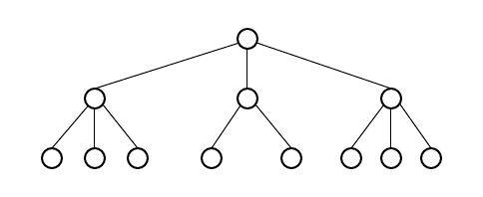
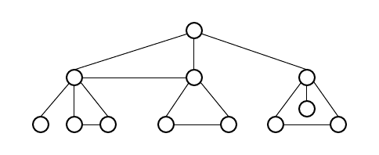
Problem
Normal tree depth of 2
Social network

Slide 15
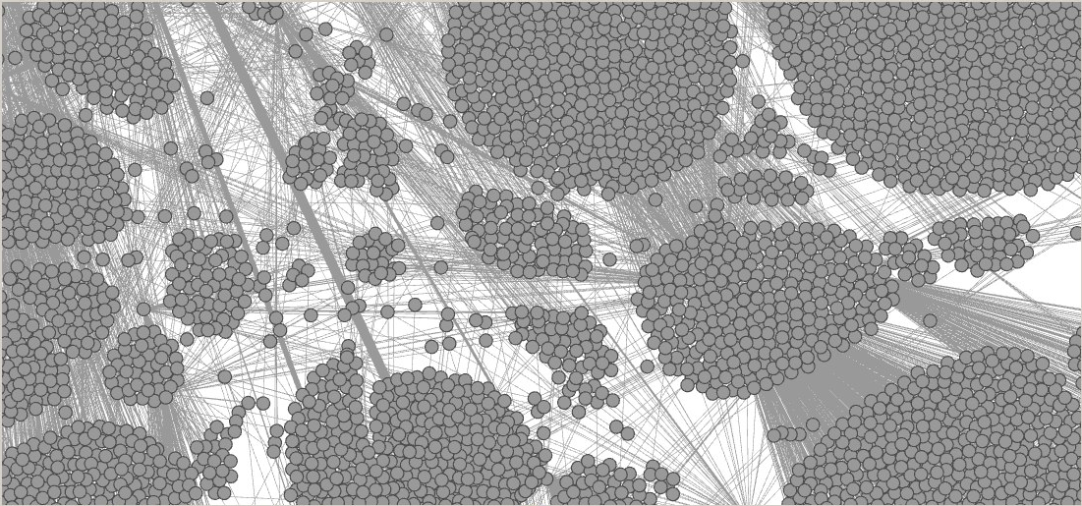
Purpose of triangles
Triangles
Clustering coefficient
Tightly knit communities
Structural hole

Slide 16

Counting triangles
Total number of triangles in the graph is proportional to the sum of cubes of its adjacency matrix eigenvalues [3].
where G represents graph, λ_{i} represents top i-th eigenvalue of adjacency matrix

Slide 17
Conclusion
Statistical methods
very powerful tool for social network analysis
Processing of large datasets requires tremendous computational power
The price for getting useful information is relatively high number of limitations

Slide 18
References
[1] Durak, Nurcan, Ali Pinar, Tamara G. Kolda, and C. Seshadhri. "Degree relations of triangles in real-world networks and graph models." Proceedings of the 21st ACM international conference on Information and knowledge management - CIKM 12, 2012. doi:10.1145/2396761.2398503.
[2] Jermakovics, Andrejs, Alberto Sillitti, and Giancarlo Succi. "Exploring Collaboration Networks in Open-Source Projects." Open Source Software: Quality Verification IFIP Advances in Information and Communication Technology, 2013, 97-108. doi:10.1007/978-3-642-38928-3_7.
[3] Tsourakakis, Charalampos E. "Fast Counting of Triangles in Large Real Networks without Counting: Algorithms and Laws." 2008 Eighth IEEE International Conference on Data Mining, 2008. doi:10.1109/icdm.2008.72.
[4] Tsourakakis, Charalampos E., U. Kang, Gary L. Miller, and Christos Faloutsos. "Doulion." Proceedings of the 15th ACM SIGKDD international conference on Knowledge discovery and data mining - KDD 09, 2009. doi:10.1145/1557019.1557111

Slide 19
Appendix
All code is here https://github.com/beisekenov/Senior-Project-I

Slide 20
Thank you for attention!

